Slide 1

LEARNING AGREEMENT
Guideline for incoming Erasmus Students
via San Bernardino 72/e
Bergamo
incoming@unibg.it

Slide 2
cancccccccwelc
Where to find the LEARNING AGREEMENT BEFORE MOBILITY:
You can download the Learning Agreement Before Mobility visiting the University of Bergamo webpage
> Global
> Erasmus - Incoming students
> Before leaving home: course catalogue and Learning Agreement

Slide 3
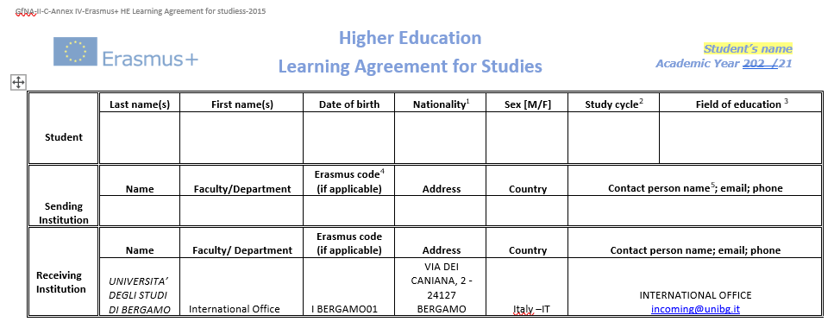
Step 1
cancccccccwelc
Complete the first section with the requested details about:
The student;
The sending institution (your home University);
The receiving institution (the University of Bergamo).

Slide 4
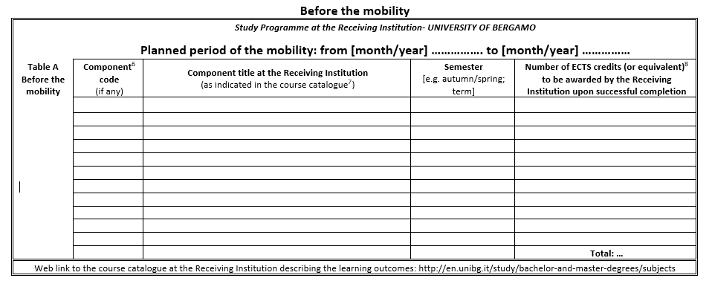
Step 2
cancccccccwelc
Complete Table A with the list of teaching units that you will attend at the receiving institution (University of Bergamo).
The University of Bergamo course catalogue is available at the following link: https://en.unibg.it/study/attendance/courses-list

Slide 5
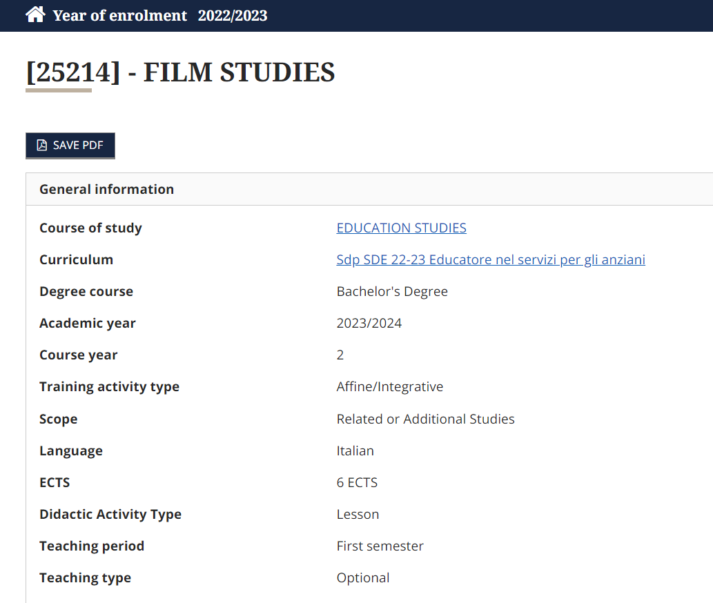
Once you select the teaching unit you are interested in, you will find out all the information required to fill in Table A of your Learning Agreement:
Code
Name of the exam
Semester
ECTS Credits.

Slide 6
The University of Bergamo offers to Incoming Erasmus/Exchange students a wide choice of courses at the Bachelor and Master level. The list of courses is updated once a year by each Department. Our degree courses are made up of teaching units
Incoming Erasmus/Exchange students can select units from all Departments keeping in mind that at least 50% of the chosen teaching units must belong to the study field of the agreement under which they have been nominated.

Slide 7
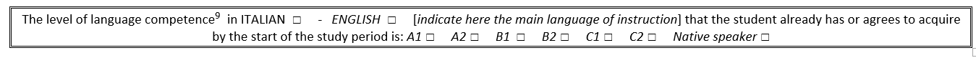
cancccccccwelc
Step 3
Fill in the language proficiency section with your level of competence.

Slide 8
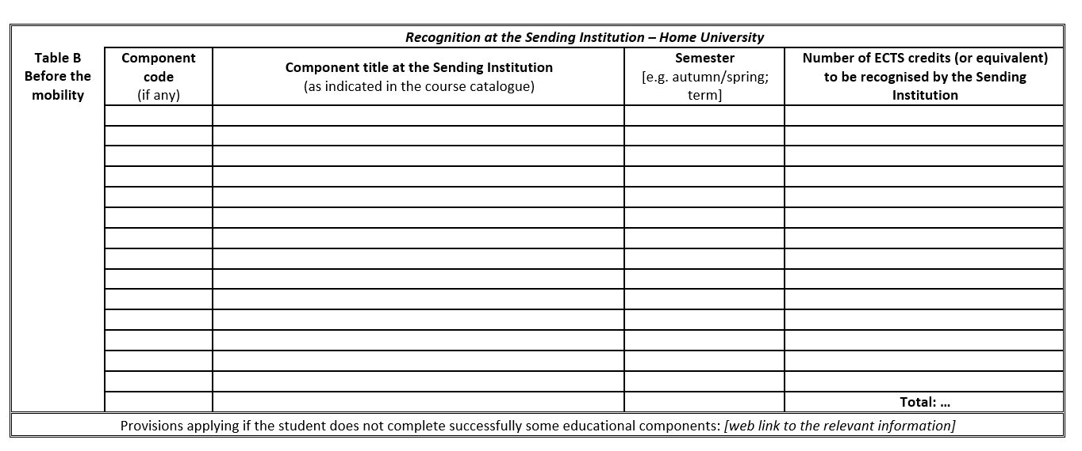
Step 4
cancccccccwelc
Complete Table B with the teaching units offered at your home university that will be replaced by the units taken at the host university.

Slide 9
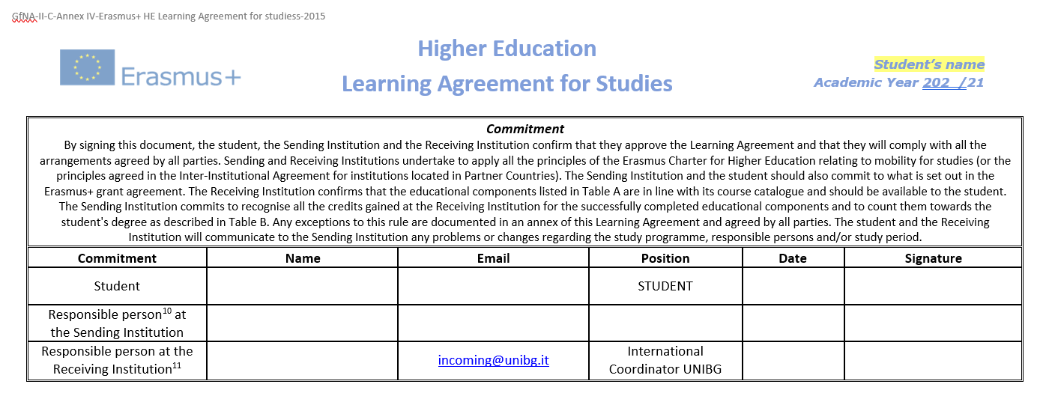
Step 5
cancccccccwelc
The document needs to be signed by all parties involved:
The student;
The responsible person at the Sending Institution;
The responsible person at the Receiving Institution.

Slide 10
cancccccccwelc
HOW TO CHANGE YOUR LEARNING AGREEMENT
Exceptional Changes can be done by filling in the DURING MOBILITY LEARNING AGREEMENT form.
You can download the Learning Agreement During Mobility from University of Bergamo webpage
> Global
> Erasmus - Incoming students
> During your Erasmus+ Stay: what to do – During mobility Learning Agreement and exams

Slide 11
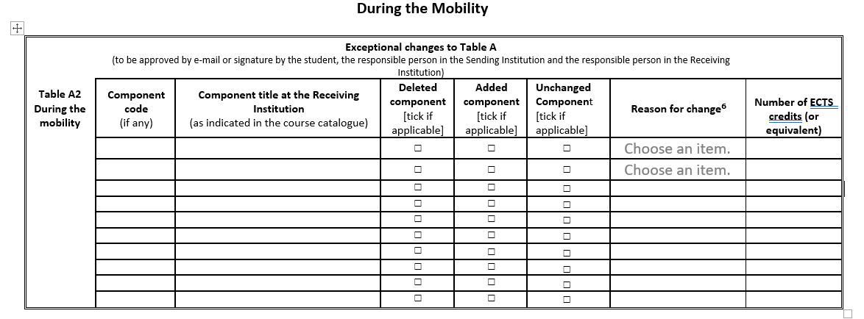
cancccccccwelc
Please verify the changes you want to make with the International Departmental coordinator in Bergamo or with the International office.
Fill in Table A2 indicating both the previous and the new exam choices, as long as the confirmed one
Remember to specify the reason for your change

Slide 12
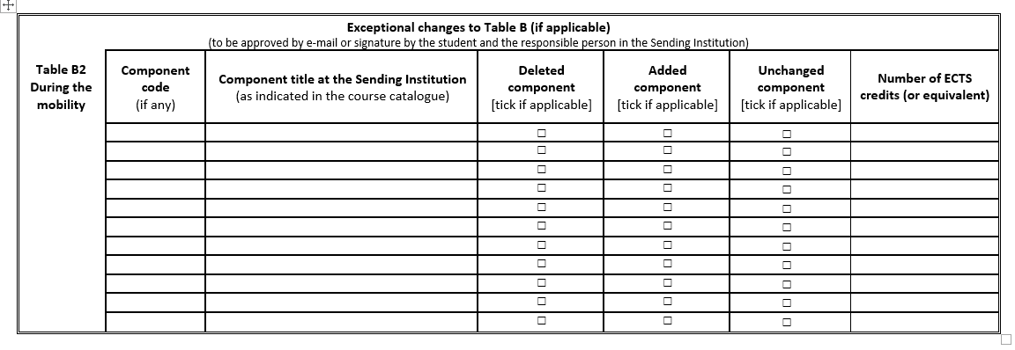
cancccccccwelc
Table B2 needs to be filled in only if the changes in the Table A2 affect the ones in Table B2.

Slide 13
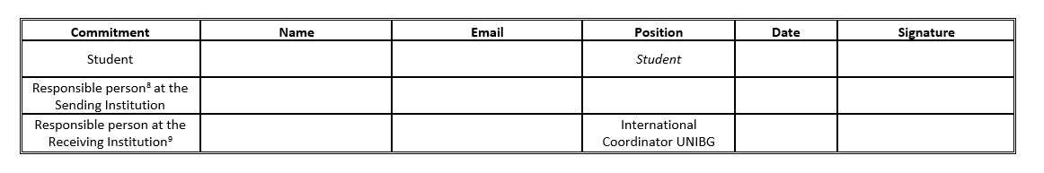
cancccccccwelc
CHANGES TO THE LEARNING AGREEMENT must be approved by:
The student;
The responsible person at the Sending Institution;
The responsible person at the Receiving Institution.

Slide 14
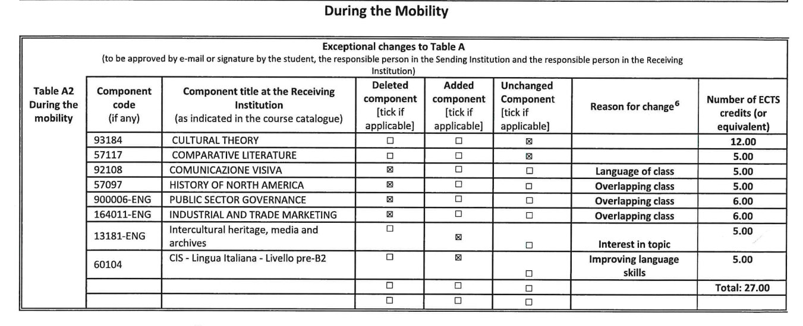
cancccccccwelc
An example of change in your LA
Fill in Table A2 with previous and the new exam choices:
In case the exam does not change, tick the box “unchanged component”;
In case of a new exam, tick the box “added component”;
In case you want to delete the exam, tick the box “deleted component”.

Slide 15

cancccccccwelc
DEADLINE TO SUBMIT THE LEARNING AGREEMENT DURING MOBILITY
Your During Mobility Learning Agreement must be submitted within three weeks after the beginning of the semester.
No changes will be allowed after the following deadlines:
March 7, 2024- All Departments
March 14, 2024- Engineering Department

Slide 16

Further information: erasmus.exchange@unibg.it

